Slide 1

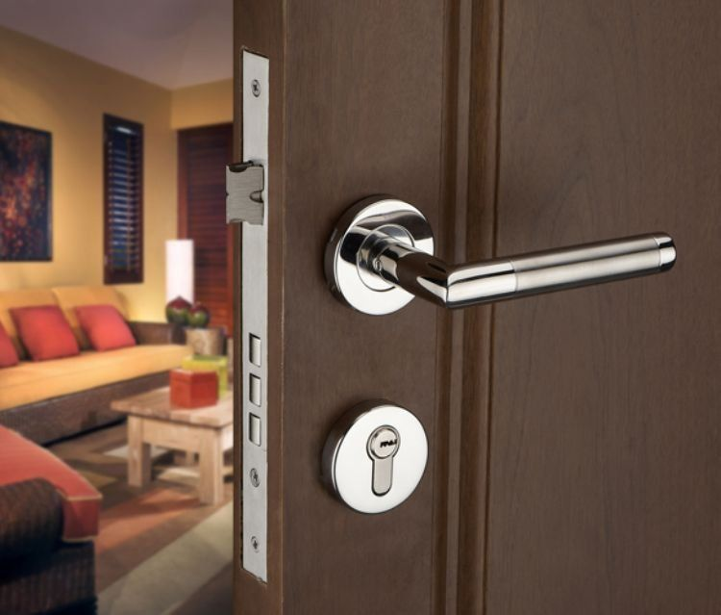
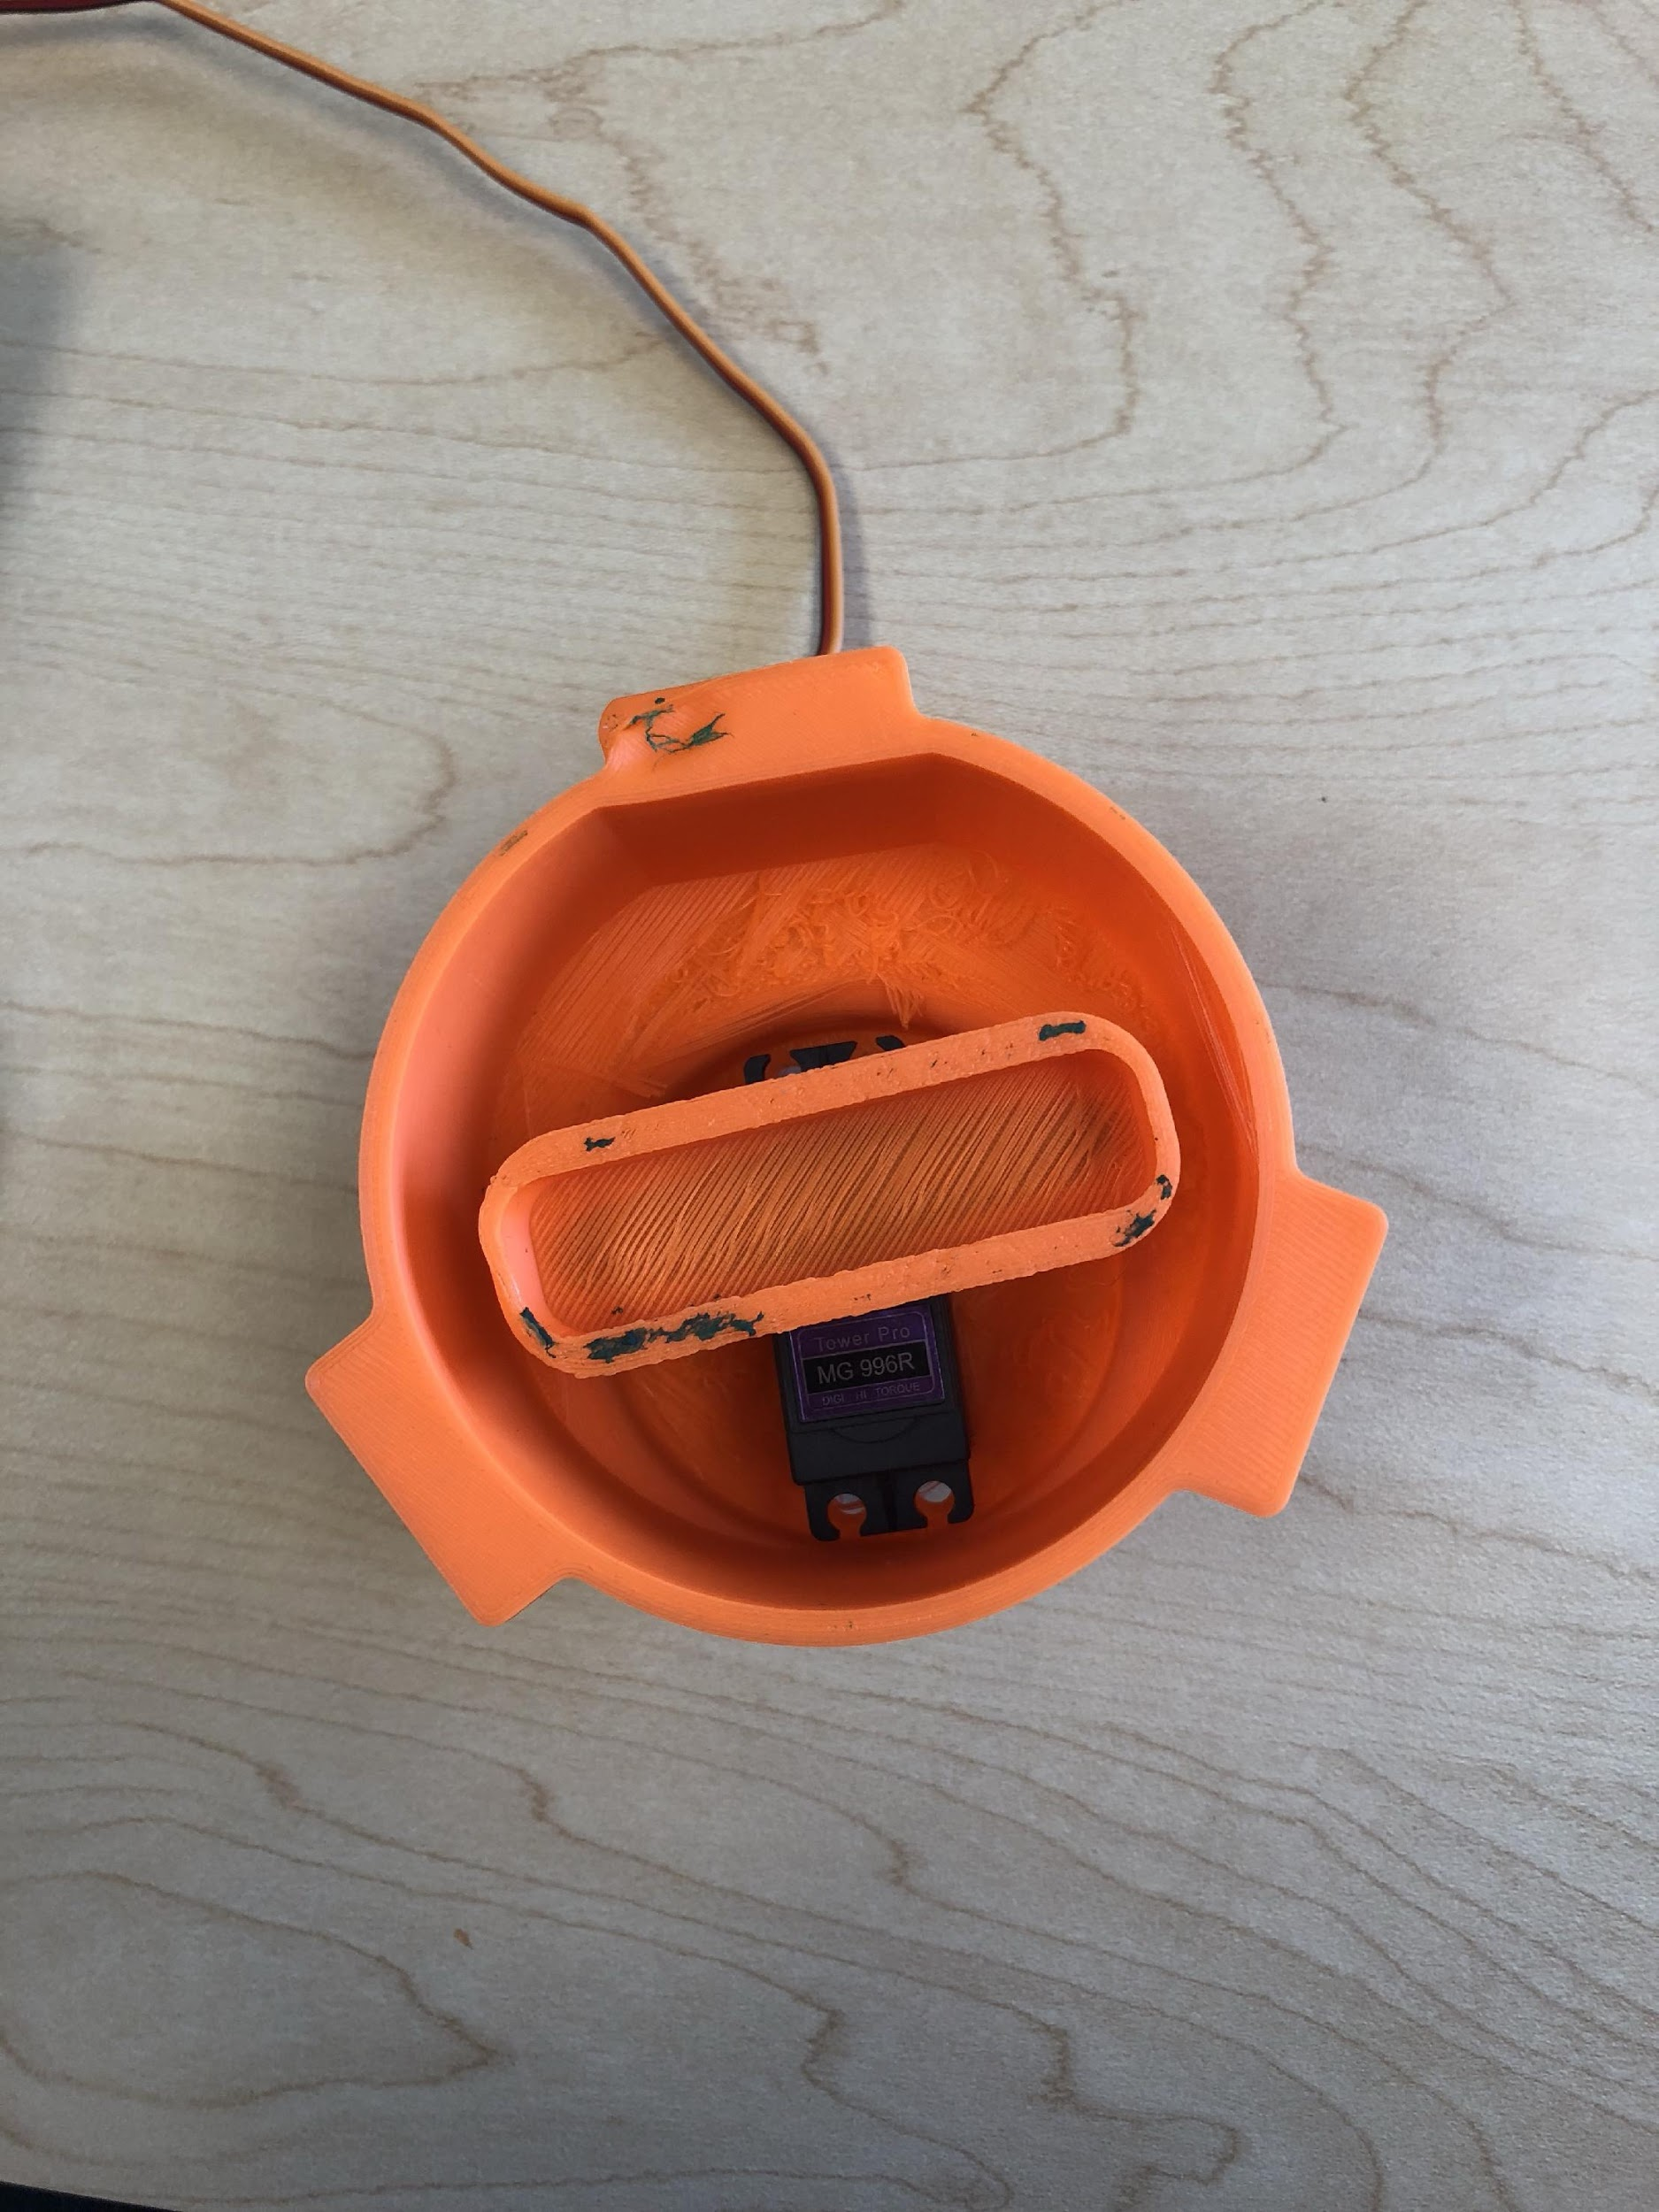
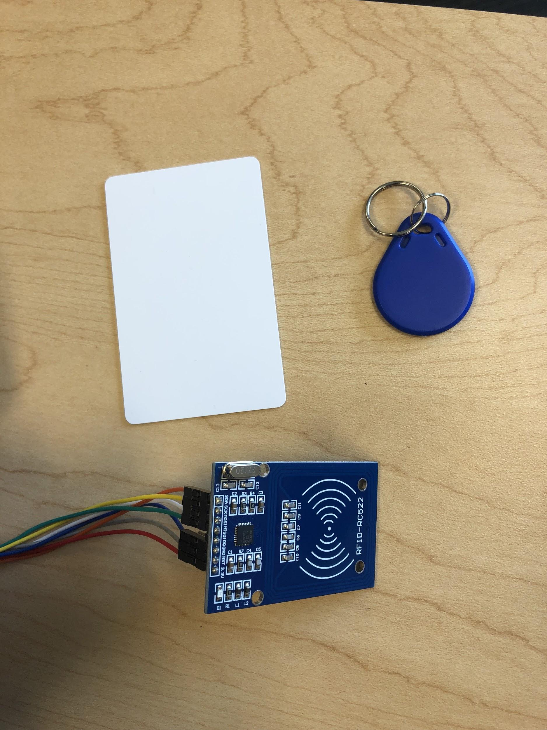
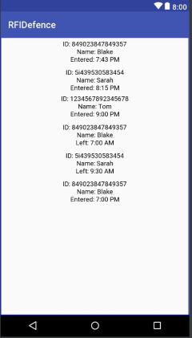
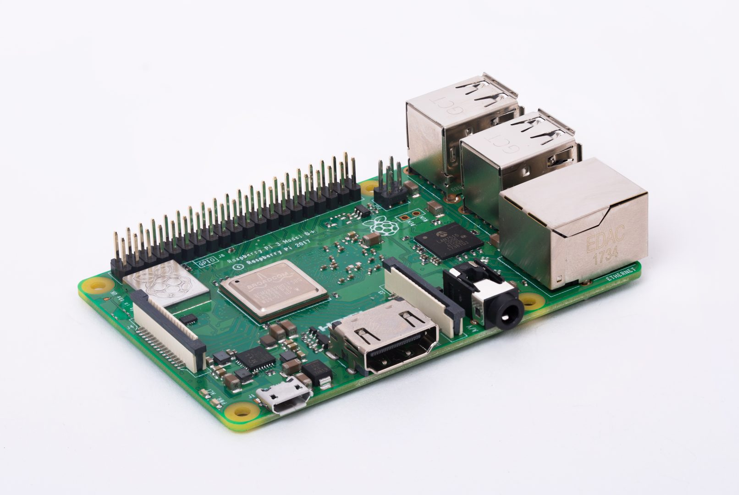
RFIDefense
Objective
The use of keys is technology that is old and needs to be replaced with something more secure. The use of physical keys creates problems:
Loss of keys
Takes time to physically unlock the door
The status of the door is not visible to the user if not present.
Many locks requires many different keys
Our Solution
A more secure home security system
Our system offers these solutions:
Uses RFIDs to grant access to the user
Fixes the issue of having the user present all the time
The user has access through the app to a log of all activity within the system
The user gets notifications whenever an unauthorized user attempts to
Technology Used
RFID tags
RFID reader
Raspberry PI 3
3D printer
How
New RFID is used, the system checks if the RFID is registered. If the RFID is already registered, the door unlocks and the status on the app also changes to display the new status of the door on the app.
Unregistered RFID used, the door remains locked and the admin is notified of the suspicious activity.
After both actions, a log is kept.
If the RFID is recognized, the door is unlocked, after 5 minutes the door automatically locks again and that activity is also logged.
The administrator has access to all the logs therefore he can see whether or not the door is locked or unlocked by checking the logs.

